Slide 1



Access to the FMA for Self-Governments
Kathryn Deo and Dr. Tim Raybould
Gathering and Engagement on FMA Access
Kelowna, BC April 21, 2026
.

Slide 2



Overview
The Governance Continuum
Origins of the FMA
Self-Government
Adaptation Regulations
Taking Action
.
Kathryn Deo, Barrister & Solicitor
& Tim Raybould, PhD

Slide 3

The Governance Continuum

Slide 4
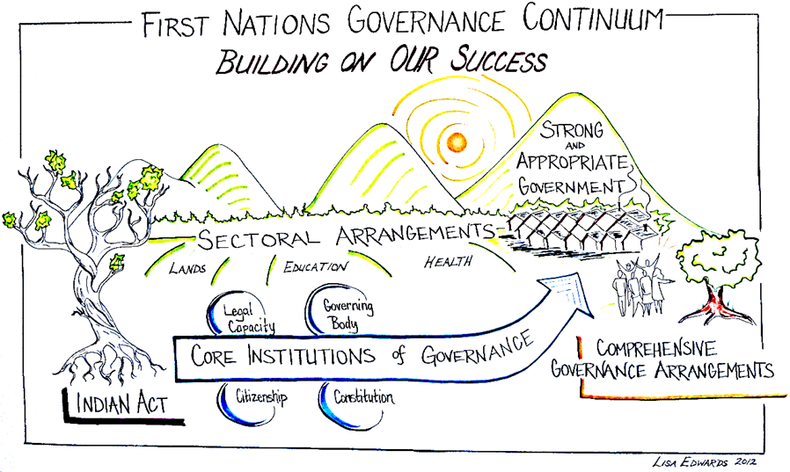

Slide 5
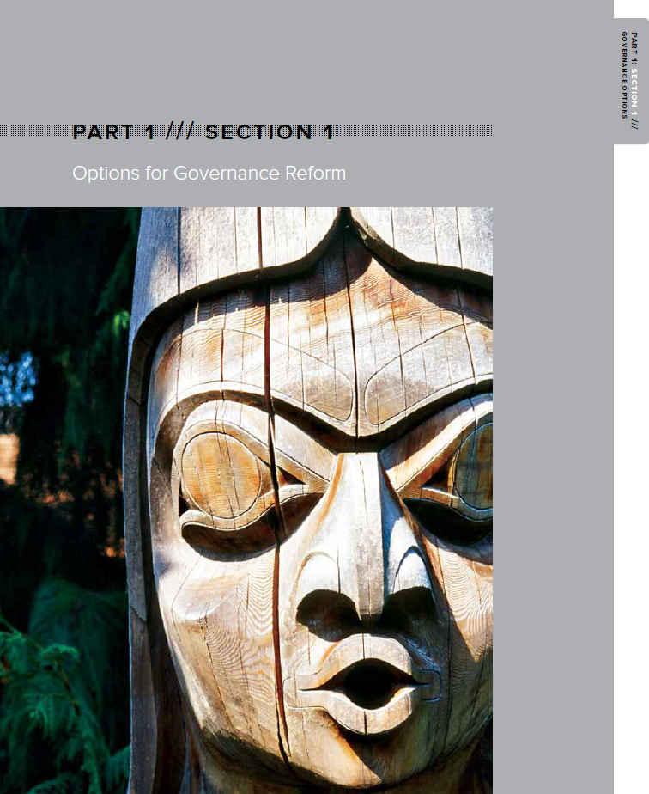
Options for State-Recognized Governance Reform (negotiated)
“Governance Continuum”:
Indian Act governance
sectoral governance initiatives
comprehensive Governance Arrangements
.
Kathryn Deo, Barrister & Solicitor
& Tim Raybould, PhD

Slide 6
National Sectoral Governance Initiatives
On-reserve
Framework Agreement on First Nation Land Management/Framework Agreement on First Nation Land Management Act (“FAFNLMA”)
First Nations Oil and Gas and Moneys Management Act
First Nations Fiscal Management Act
On and Off-reserve
An Act respecting First Nations, Inuit and Métis children, youth and families
First Nations Commercial and Industrial Development Act
.
Kathryn Deo, Barrister & Solicitor
& Tim Raybould, PhD

Slide 7
Comprehensive Governance Arrangements
James Bay Cree, QC (land claim)
Sechelt, BC (stand alone – trilateral)
Yukon (land claim)
Vuntut Gwitchin,
Champagne and Aishihik,
Nacho Nyak Dun,
Teslin Tlingit,
Selkirk,
Little Salmon/ Carmacks,
Tr’ondëk Hwëch’in,
Ta’an Kwach’an,
Kluane First Nation,
Kwanlin Dün,
Carcross/Tagish
.
Kathryn Deo, Barrister & Solicitor
& Tim Raybould, PhD

Slide 8
Comprehensive Governance Arrangements (cont.)
Nunavut (land claim – public government)
Nisga’a, BC (land claim – 5 former bands)
Nunatsiavut, Labrador (land claim)
Westbank, BC (stand alone – bilateral)
Tlicho, NWT (land claim)
Tsawwassen, BC (land claim)
Maa-nulth, BC (land claim – four former bands)
Sioux Valley Dakota Nation, MB (stand alone – trilateral)
Yale, BC (land claim – will not be coming into force)
Tla’amin, BC (land claim)
Déline Got'ine, NWT (land claim)
Crees of Eeyou Istchee, QC (stand alone building on James Bay Cree arrangements)
Whitecap Dakota, SASK (stand alone – bilateral)
Kathryn Deo, Barrister & Solicitor
& Tim Raybould, PhD

Slide 9
The Origins of the FMA

Slide 10
Origins of the FMA
provide participating First Nations with tools needed to build their own economies
stronger tax powers than section 83 of the Indian Act with the the evolution of the Indian Taxation Advisory Board to the FNTC
removing uncertainty regarding borrowing under the Indian Act
key roles played by Kamloops and the Indian Taxation Advisory Board (Manny Jules - FNTC), Squamish (Harold Calla – FMB) and Westbank (Deanna Hamilton - FNFA)
meeting the needs of the market (investor confidence)
while the Indian Act ‘band’ was the starting point, the vision was always self-government outside of the Indian Act

Slide 11
Key Aspects of the FMA
broad tax powers: property tax, property transfer tax, business activity tax, fees for services
important in the context of major projects
strong enforcement powers
differential taxation
no statutory requirement for requisitioning authorities
section 87 tax exemption continues
jurisdiction applies to all persons (members and non-members)
strong national Institutions to support FN capacity and the regime (strength in numbers)
access to pooled borrowing
national standards and support for financial administration laws
support for infrastructure

Slide 12
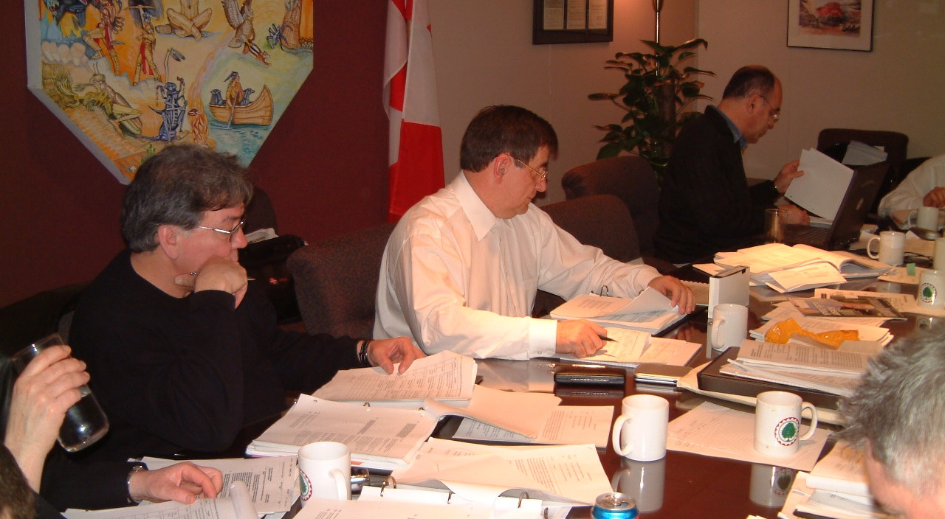

Slide 13


Slide 14
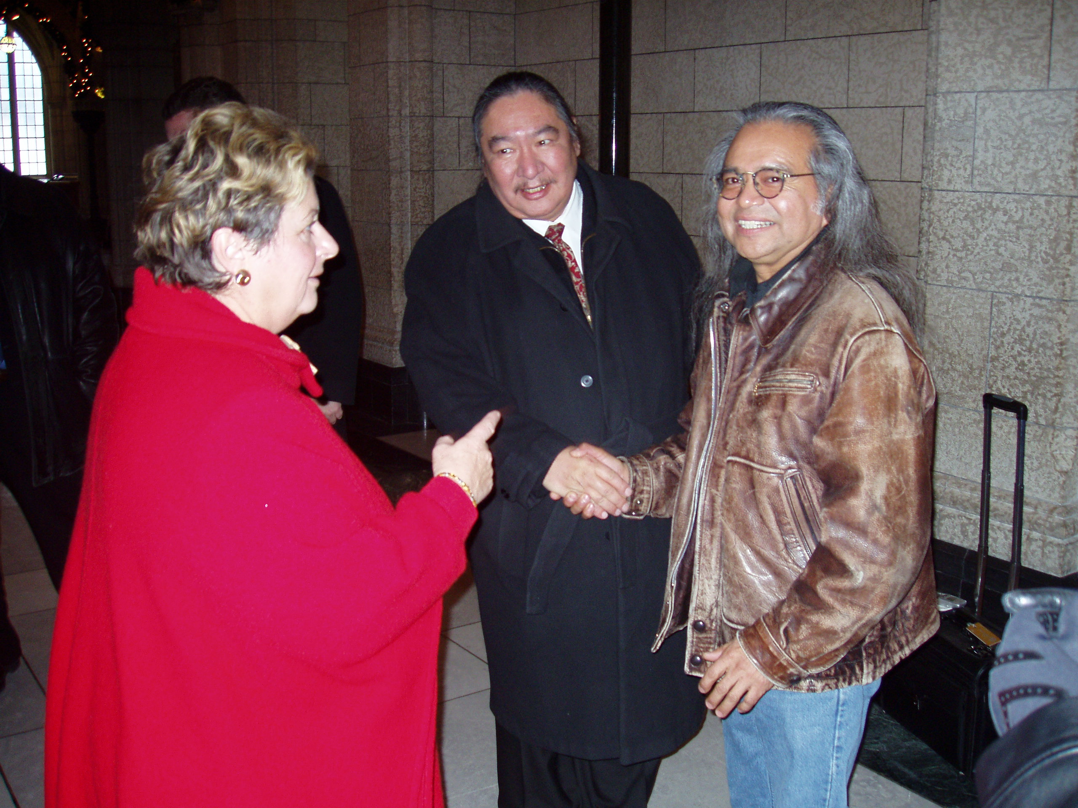

Slide 15
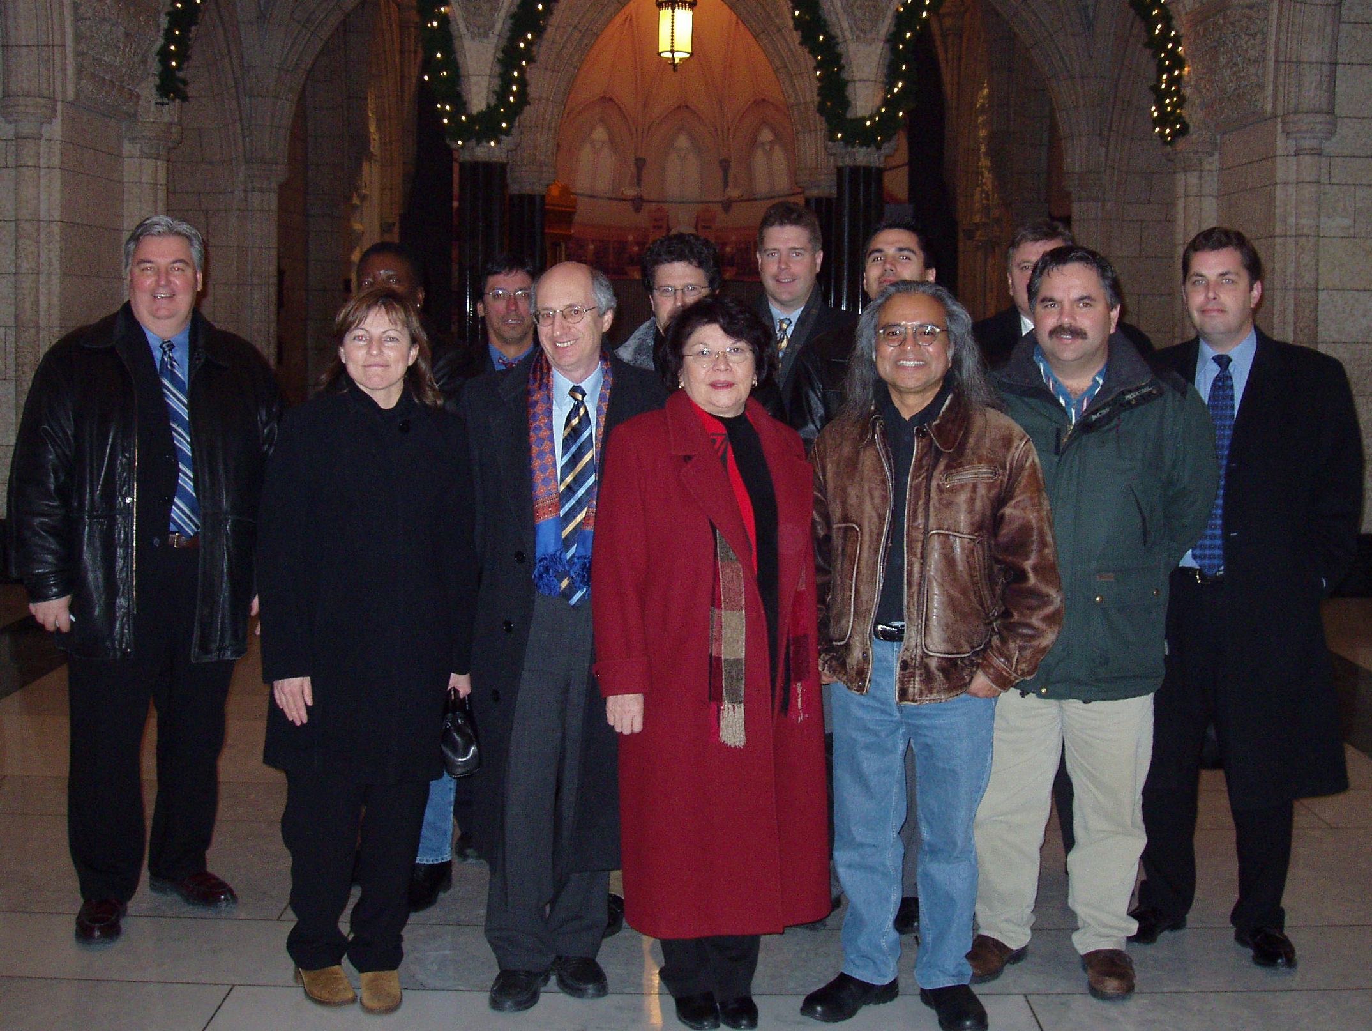

Slide 16
Leading the Way…
at least 373 First Nations have opted into the FMA regime
approximately 150 First Nations taxing under FMA
annual property tax revenues exceed $100M per year
assessed values of taxable properties is in the many billions
other taxes (e.g., business taxes, property transfer tax) collected exceed $12M per year
at least 299 First Nations have developed Financial Administration Laws (“FALs”) that meet FMB standards
FNFA has issued over $4.3B in bonds

Slide 17
Self-Government

Slide 18
UNDRIP
Article 3 Indigenous peoples have the right to self-determination. By virtue of that right they freely determine their political status and freely pursue their economic, social and cultural development.
Article 4 Indigenous peoples, in exercising their right to self-determination, have the right to autonomy or self-government in matters relating to their internal and local affairs, as well as ways and means for financing their autonomous functions. Article 5 Indigenous peoples have the right to maintain and strengthen their distinct political, legal, economic, social and cultural institutions, while retaining their right to participate fully, if they so choose, in the political, economic, social and cultural life of the State.
Kathryn Deo, Barrister & Solicitor
& Tim Raybould, PhD

Slide 19
UNDRIP - Implementation
Article 38
States, in consultation and cooperation with indigenous peoples, shall take the appropriate measures, including legislative measures, to achieve the ends of this Declaration.
.
Kathryn Deo, Barrister & Solicitor
& Tim Raybould, PhD

Slide 20
FMA and Self-Government
close to 30 self-governing Indigenous governments in Canada, under 16 different SGAs, treaties and other arrangements
Westbank First Nation is self-governing; its enabling legislation contemplates regulations adapting the FMA (s. 8.1)
many First Nations scheduled to the FMA are also negotiating self-government arrangements, e.g.:
Musqueam Indian Band
Williams Lake First Nation
Te’mexw Treaty Association members (Beecher Bay (SC’IȺNEW), Malahat, Snaw-Naw-As, Songhees and T’Sou-ke)
signatories and potential signatories to the Anishinabek Nation Governance Agreement (“ANGA”)
many of these communities are already taxing under the FMA

Slide 21
Evolution to Self-Government
framers of the FMA always contemplated that self-governments would have the option of benefiting from the tools of the FMA, including exercising tax powers infrastructure
FMA s.141 provides for FMA to be adapted for the benefit of SGIGs:
141 (1) For the purpose of enabling an Indigenous group that is a party to a treaty, land claims agreement or self-government agreement with Canada to benefit from the provisions of this Act or obtain the services of any body established under this Act, the Governor in Council may make any regulations that the Governor in Council considers necessary, including regulations
adapting any provision of this Act or of any regulation made under this Act; and
restricting the application of any provision of this Act or of any regulation made under this Act.

Slide 22
Developing Regulations for Self-governments
Modern First Nations Legislation Annotated, 2012 Edition, Paul Salembier et. al; commentary on FMA s. 141:
“These groups [that have negotiated self-government agreements] could, however, request that regulations be made under this section to enable them to exercise powers or become borrowing members under the FNFSMA. Because the FSFMA is geared to First Nations that have been exercising taxation power under s. 83 of the Indian Act, certain accommodations may be necessary in order for the FNFSMA to apply properly to such self-governing aboriginal groups. Regulations made under this section can therefore adapt the provisions of the FNFSMA in whatever manner is necessary in order to achieve this objective.“
(p. 201) (emphasis added) accommodations may be necessary in order for t

Slide 23
Adaptation Regulations

Slide 24
Shifting Federal Policy
today there are no regulations adapting the FMA for the benefit of self-governments who wish to use the tax powers under the FMA, or borrow using tax revenues
contrary to intention of the framers of the FMA, at some point federal policy (Finance Canada), became that not all parts of the FMA would apply to self-governments
Finance Canada is currently reviewing this policy considering representations made by self-governing First Nations and those negotiating self-government
while Canada has decided to not provide self-governments with access to the FMA taxation regime at this time, Canada is willing for its officials to engage further with stakeholders

Slide 25
FMA Adaptation Regulations
Westbank First Nation, a self-government, has been seeking adaptation regulations since at least 2008
modern treaty First Nations in BC including Tla’amin and the Maa-Nulth First Nations worked with the Institutions, Canada and BC on regulations under FMA s. 141 since 2013
on March 8, 2025, draft regulations adapting the FMA for the purposes of borrowing using other revenues were published in the Canada Gazette (will come into force when first SGIG is scheduled)

Slide 26
FMA Adaptation Regulations
Westbank and Musqueam have prepared drafts of what adaptation regulations could look like that include tax powers
Musqueam’s draft regulations adapt the First Nations Fiscal Management Adaptation Regulations to include tax powers
scope of tax powers set out at s. 5.1(1) of Musqueam’s draft; includes:
property tax (5.1(1)(a)(i) and (ii))
property transfer tax: “taxes payable on the transfer of an interest in the Indigenous group’s land” (5.1(1)(a)(iii))
business activity tax (5.1(1)(a)(iv))

Slide 27
Taking Action

Slide 28
Supporting Access to the FMA for Self-Governments
many, if not all, First Nations are contemplating, to some extent, the implementation of the inherent right of self-government and moving beyond the Indian Act
sectoral governance initiatives do not need to be dead ends on the path to comprehensive self-government recognition
many of the First Nations that are currently collecting taxes in accordance with the FMA will wish to continue to have the same powers after self-government and based on the same policy rationale that went into the framing of the FMA

Slide 29
Supporting Access to the FMA for Self-Governments
engage with Canada (Finance and CIRNA) as stakeholders as Finance’s policy on participation in the FMA post self-government is revisited
work with Westbank, Musqueam, Williams Lake and others to encourage development of broad adaptation regulations
indicate your support to FNTC, FMB, FNFA and FNII
speak with your MP

Slide 30



Questions?
VICTORIA | VANCOUVER
Kathryn Deo
Barrister & Solicitor
Direct: (250) 298-8178
kathryn@arbutuslaw.ca
arbutuslaw.ca
Timothy Raybould
Consultant, PhD
timraybould@jwrgroup.ca

